Slide 1
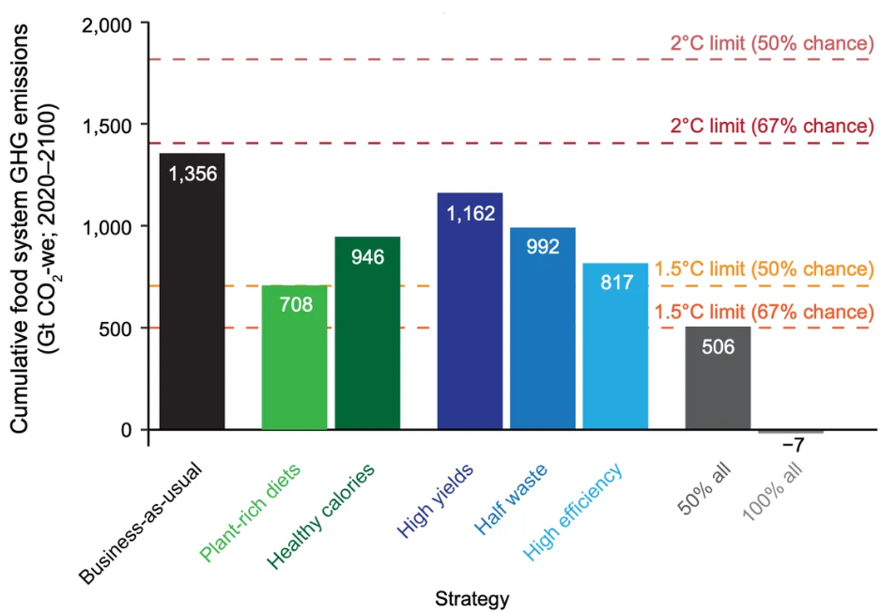
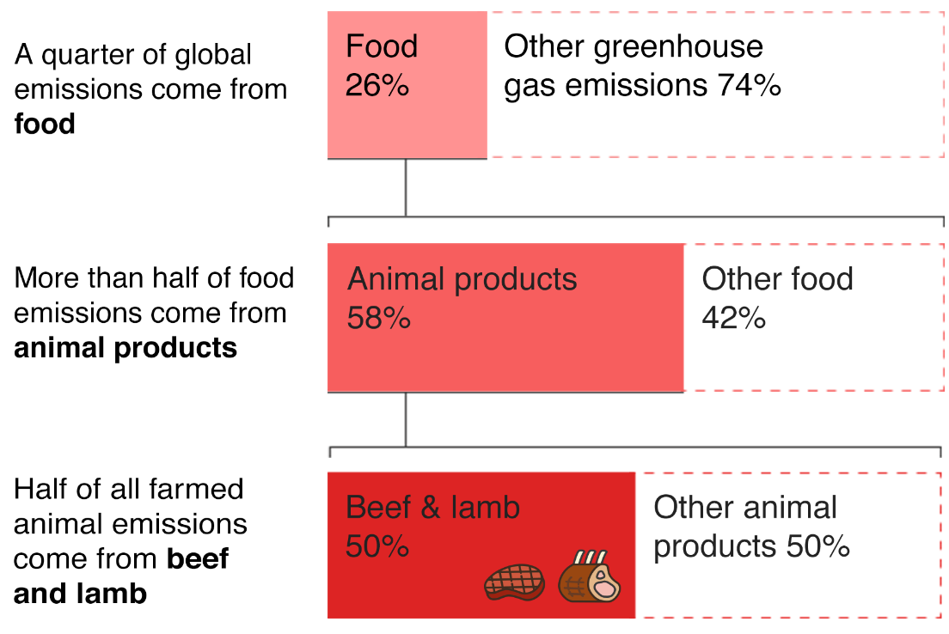
Effect of Adopting Veganism on Climate Change
Introduction
Veganism is a new form of lifestyle that is based on food habits. In veganism, the food diet includes all the products which are based on the plant and its products. This form does not encourage any kind of food products which are animal based or made by animal-based products. People are now adopting this new food habit and it is encouraged a lot too as it has various positive effects on the environment and is good for the animal life stock too.
Benefits of Veganism
The first major benefit is the emission of greenhouse gases. It was found that plant-based meat emits 90% fewer greenhouse gases as compared to animal-based meat. The amount of carbon which is saved by consuming just one plant-based meal in comparison to an animal-based meal will be sufficient to run a car for a day. The carbon footprints are reduced by a good amount just by avoiding animal-based food products (The Human League, 2021).
The processing of animal-based products such as meat, etc. requires lots of processing to make them edible. For example, 31.5 Kilowatt hours of energy is needed to make only one pound of beef and in the nearly same amount, one can use the refrigerator for a whole month. On the other hand, plant-based protein sources such as beans, nuts, etc. do not require that much processing and energy making them a better choice during climate emergencies (The Human League, 2021).
Graph: Showing positive impacts of veganism on both demand and supply side.
Source: (Pike, 2020)
To maintain the livestock lots of cropland is needed which is created by cutting down the forests i.e., deforestation. By deforestation, not only the plant and their species are going lost but it also affects the species population of the animals living in that area and eventually resulting in their extinction in long run. But if veganism is adopted then there will be no such need for deforestation but will require more plantations and that will be beneficial for the environment in many ways (The Human League, 2021).
Note
It is not suggested for every individual in the world to turn vegan and just used food-based products. There are some countries and some parts of the world where people don’t have any other option instead of feeding on animal products and meat and it is not expected for such people to become vegan too. But surely, wherever possible, people can choose a vegan diet instead of non-vegan food (Harrabin, 2019).
References
Harrabin, R. (2019). Plant-based diet can fight climate change – UN. Retrieved on 10th August 2022, From https://www.bbc.com/news/science-environment-49238749
Pike, L. (2020). Why we need policies to reduce meat consumption now. Retrieved on 10th August 2022, From https://www.vox.com/21562639/climate-change-plant-based-diets-science-meat-dairy
The Human League. (2021). 14 Reasons why going vegan is the best thing we can do for the planet. Retrieved on 10th August 2022, From https://thehumaneleague.org/article/environmental-benefits-of-veganism
Veganism also helps in the conservation of water. It was found in a study that out of total water used in agriculture, nearly 41% is used just to maintain the livestock feed. If the number of livestock needed for consumption is reduced then the amount of water needed can also be reduced and it can be saved for the future (The Human League, 2021).
Picture: Percentage of greenhouse gas emission via animal-based products.
Source: (Harrabin, 2019)
According to the current reports, 8.9% of the world’s population is still suffering from hunger on the other hand there are some who have access to a lot of food and they waste it as well. If we move to vegan dietary habits then it is possible to save nearly about 75% of the global farmland that is used by livestock for grazing and maintenance purposes and that 75% of that land can be used to grow the plants and plant-based used products which will be used to fight the hunger on a mass level (The Human League, 2021).

